Slide 1
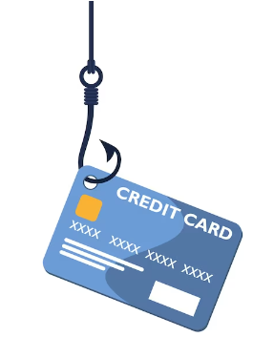
PREDICT FRAUDULENT CREDIT CARD TRANSACTIONS
Abhishek Singh
Notes:
Objective

Slide 2

AGENDA
Problem Statement
Business Problem Overview
Approach
Data Understanding
Data Preparation
Model Selection and Build
Result
Appendix
Data Understanding
Bivariate Analysis
Notes:
Objective

Slide 3
PROBLEM STATEMENT
Fraudulent activities have increased severalfold, with around 52,304 cases of credit/debit card fraud reported in FY'19 alone. Due to this steep increase in banking frauds, it is the need of the hour to detect these fraudulent transactions in time in order to help consumers as well as banks, who are losing their credit worth each day.
Every fraudulent credit card transaction that occur is a direct financial loss to the bank as the bank is responsible for the fraud transactions as well it also affects the overall customer satisfaction adversely.
The aim of this project is to identify and predict fraudulent credit card transactions using machine learning models.
Notes:
Objective

Slide 4
BUSINESS PROBLEM OVERVIEW
Retaining high profitable customers is the number one business goal for many banks. Banking fraud, however, poses a significant threat to this goal for different banks. In terms of substantial financial losses, trust, and credibility, this is a concerning issue for both banks and customers alike.
It has been estimated by Nilson Report that by 2020, banking frauds would account for $30 billion worldwide. With the rise in digital payment channels, fraudulent transactions are occurring in new and different ways. This number is increasing rapidly.
In the banking industry, credit card fraud detection using machine learning is not just a trend. It is necessary for players in the industry to put proactive monitoring and fraud prevention mechanisms in place. Machine learning is helping them reduce time-consuming manual reviews, costly chargebacks and fees, and denials of legitimate transactions.
Notes:
Objective

Slide 5
APPROACH
DATA UNDERSTANDING
The data set includes credit card transactions made by European cardholders for 2 days in September 2013. Out of the 284,807 transactions in total, 492 were fraudulent.
This data set is highly unbalanced, with the positive class (frauds) accounting for 0.172% of the total transactions. The data set has also been modified with principal component analysis (PCA) to maintain confidentiality.
Apart from “time” and “amount,” all the other features (V1, V2, V3, up to V28) are the principal components obtained using PCA. The feature “time” contains the seconds elapsed between the first transaction in the data set and the subsequent transactions. The feature “amount” is the transaction amount.
The feature “class” represents class labeling, and it takes the value of 1 in cases of fraud and 0 in others.
Notes:
Objective

Slide 6
APPROACH
DATA UNDERSTANDING
The Data has 32 features from V1-V28 which are unknown for confidentiality, Time, Amount and Class
The input features are V1-V28, Time and Amount
The target variable is Class
The Data does not have any missing values as evident from the below mentioned code, thus need not be handled
The Data consists of all numerical features, and only the Target Variable Class is a categorical feature.
Class 0: Legitimate Transaction, Class 1: Fraud Transaction
The Dataset is highly imbalanced as evident from the countplot with majoritarian class label '0' and minority class label '1'
Notes:
Objective

Slide 7
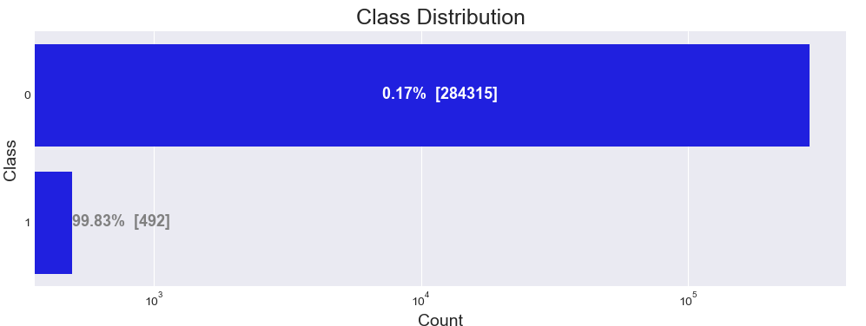
APPROACH
DATA UNDERSTANDING
Notes:
Objective

Slide 8
APPROACH
DATA PREPARATION
The Data does not have any missing values and hence, need not be handled.
The Data has only Target Variable Class as the categorical variable.
Remaining Features are numerical and need to be only standardized for comparison after balancing the dataset
The mean of the amount of money in transactions is 88.34
The standard deviation of amount of money in transactions is 250.12
The time is distributed throughout the data equitably and hence, serves as an independent feature
As we have derived the Day/Hour/Minutes from the time column we will drop Time
We will use Power Transformer package to make the distribution more Gaussian
Notes:
Objective

Slide 9
MODEL SELECTION AND BUILD
Use stratified split to ensure at least 100 class 1 rows in a test split. 80-20 train test split ratio is good to be used.
Logistic regression works best when the data is linearly separable and needs to be interpretable.
KNN is also highly interpretable, but not preferred when we have a huge amount of data as it will consume a lot of computation. It is a simple, supervised machine learning algorithm used for both classification and regression tasks. The k value in KNN should be an odd number because we have to take the majority vote from the nearest neighbors by breaking the ties.
The decision tree model is the first choice when we want the output to be intuitive, but they tend to overfit if left unchecked.
In Gradient Boosted machines/trees newly added trees are trained to reduce the errors (loss function) of earlier models.
XGBoost is an extended version of gradient boosting, with additional features like regularization and parallel tree learning algorithm for finding the best split.
Notes:
Objective

Slide 10
MODEL SELECTION AND BUILD
Following are models to be run. SVM (support vector Machine) model was not run due to extensive processive power requirement. All models were run taking into consideration variations for Power Transformer, Repeated Kfold cross validation, Stratified Kfold Cross validation, Random Undersampling, SMOTE and Adasyn.
Logistic Regression with L2 Regularisation
Logistic Regression with L1 Regularisation
KNN
Decision tree model with Gini criteria
Decision tree model with Entropy criteria
Random Forest
XGBoost
Notes:
Objective

Slide 11
RESULT
Looking at the results overall results (without sampling and sampling) Logistic Regression with L2 Regularisation with RepeatedKFold Cross Validation has provided best results.
Model Name: Logistic Regression with L2 Regularisation with RepeatedKFold Cross Validation
Model Accuracy: 0.998894
roc_value: 0.992420
Threshold: 0.001544
Notes:
Objective

Slide 12

APPENDIX
Notes:
Objective

Slide 13
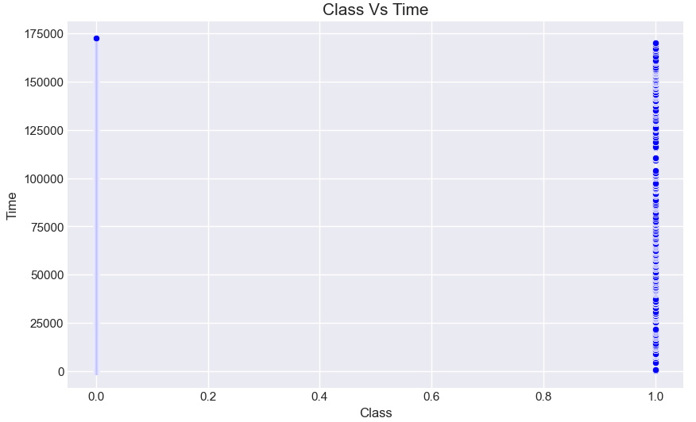
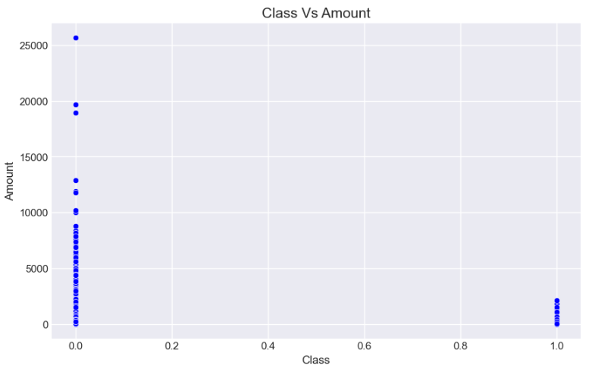
DATA UNDERSTANDING – BIVARIATE ANALYSIS
Notes:
Objective

Slide 14
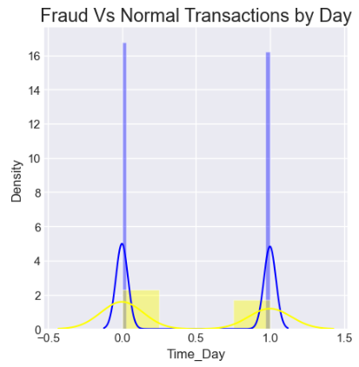
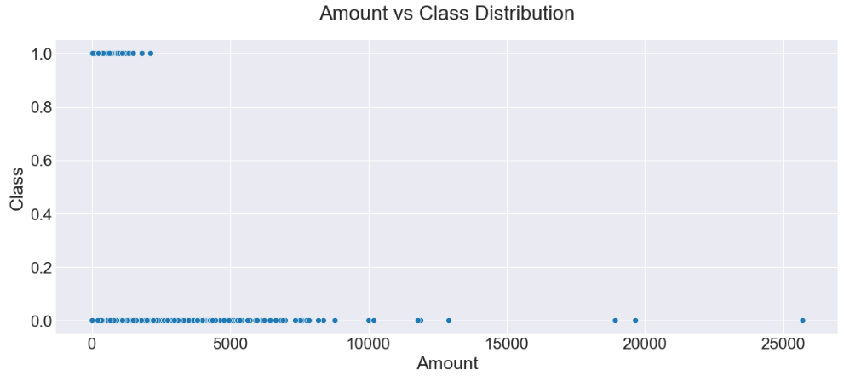
DATA UNDERSTANDING – BIVARIATE ANALYSIS
Notes:
Objective

Slide 15
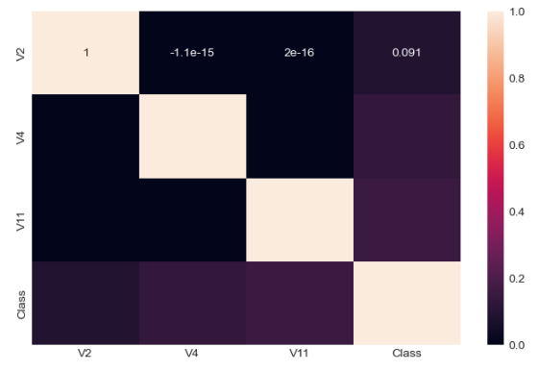
DATA UNDERSTANDING – BIVARIATE ANALYSIS
Notes:
Objective

Slide 16
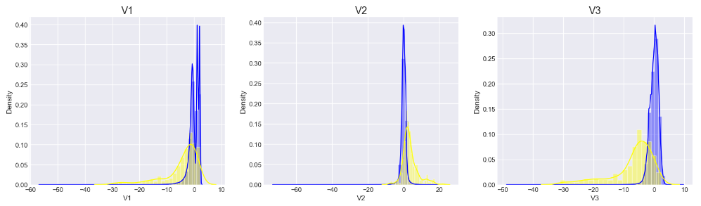
DATA UNDERSTANDING – SKEWNESS CHECKED FOR FRAUD AND NON-FRAUD RECORDS (example below)
Non-Fraudulent – Blue
Fraud Records - Yellow
Notes:
Objective

Slide 17
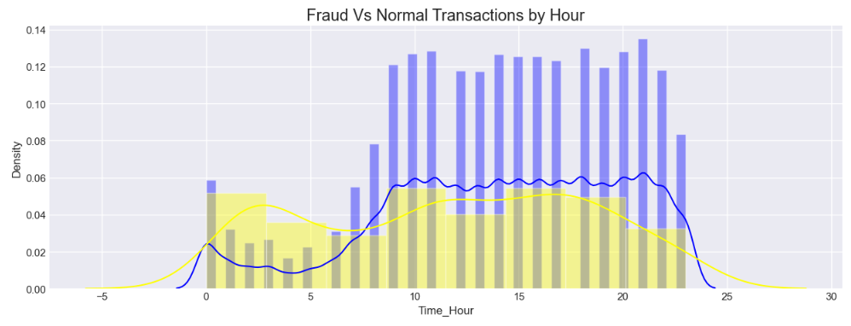
DATA UNDERSTANDING – BIVARIATE ANALYSIS
Non-Fraudulent – Blue
Fraud Records - Yellow
Notes:
Objective

Slide 18

Notes:
Objective

